Slide 1
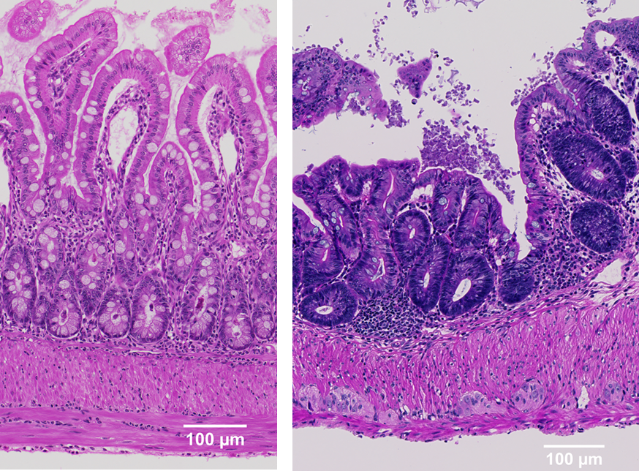
Quantification of staining variability
Hematoxylin and Eosin
staining can vary with fixation, tissue processing, sections, reagents, timing…
In this exercise we will learn how to measure this variability.
Workflow in QuPath:
create project, add images
separate stains
detect tissue / make annotation
measure OD sum
measure intensity of Hematoxylin & Eosin
export the data

Slide 2
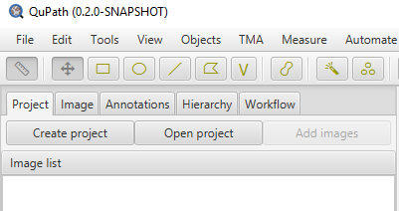
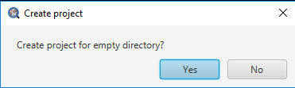
Working with projects
Things worth knowing about projects:
Projects are undergoing rapid evolution in QuPath and it’s best not to mix projects from different versions of the software!
Tip: you can also drag an empty folder into main QuPath window to start a new project

Slide 3

Working with projects
To add images to your project
Create a subfolder called images in your QuPath project
Copy images to images
Add them with Add images button
What kind of images can be opened with QuPath?
Images supported by OpenSlide and Bio-formats (including those from most major microscope manufacturers). PNG, JPEG, ImageJ TIFF
For an image file to work with QuPath, an open source reader needs to exist. Some proprietary formats that don't have a reader available can't be used, unfortunately.
https://github.com/qupath/qupath/wiki/Supported-image-formats
Tips: Make sure that each image has a unique name
You can open remote slides shared using OMERO server

Slide 4
Create a new project
Raw files:
E01. From sample to slide I
(December 7, 12, 27, 28.czi)
Create a new, empty folder, choose as your project, make a subfolder images, copy image files, add metadata (stain=HE), save your project
Projects will:
Keep things organized
Improve reproducibility
Help with reusability
Save your time

Slide 5
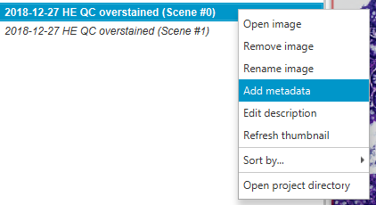
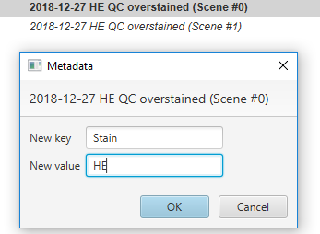
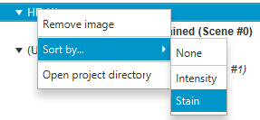
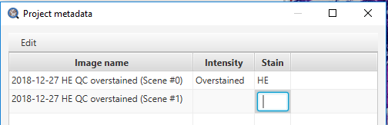
Working with projects
Add metadata to help organize your files
Metadata use ideas:
Stain used
Treatment status
Antibody concentration
Scanner type
QC status
...
You can sort your files on metadata - helpful with large projects
Tip: change many files at once using Project -> Edit project metadata

Slide 6
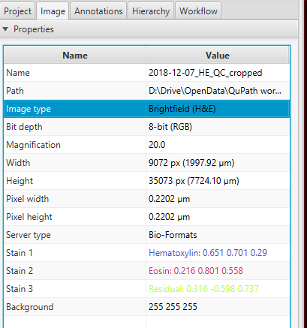
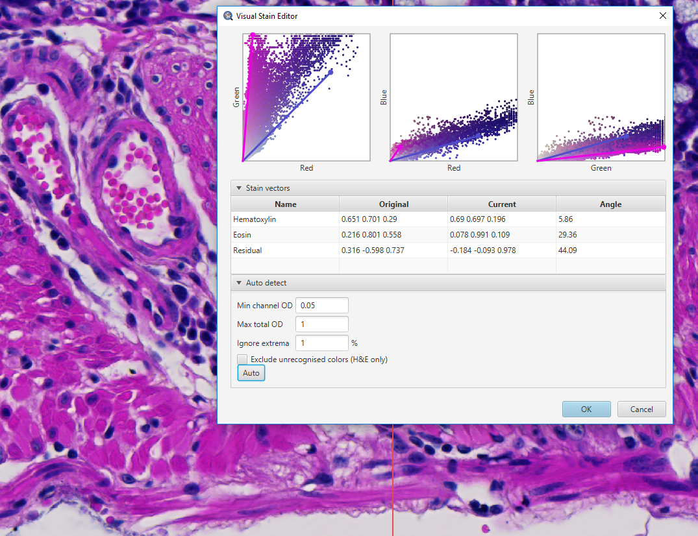
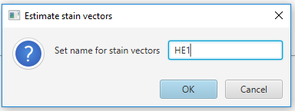
Stain separation
Verify that the slide is set to an appropriate image type
Select small rectangular region of interest that contains examples of H&E and background, then run Estimate stain vectors
Hematoxylin: cell nuclei
Eosin: erythocytes, muscles, collagen
Check the results: click keys 1, 2, 3 to see the separated stains
Tip: ctrl+L is a shortcut for Command List - very handy when you want to quickly find a command - try vectors

Slide 7
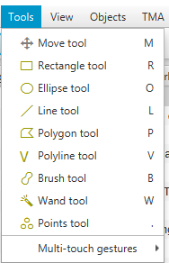
Tissue detection
Tissue detection will not work well on these cropped slides (no tissue borders). Let’s Create full image annotation (Ctrl+Shift+A). Alternatively, you can mark it manually for this set using rectangle tool and select all of the tissue.
Tip: there is a lot of useful shortcuts for tools in QuPath
R - rectangle, O - ellipse, L - line, P - polygon, V - polyline, B - brush, W - wand, . - points, M - move

Slide 8
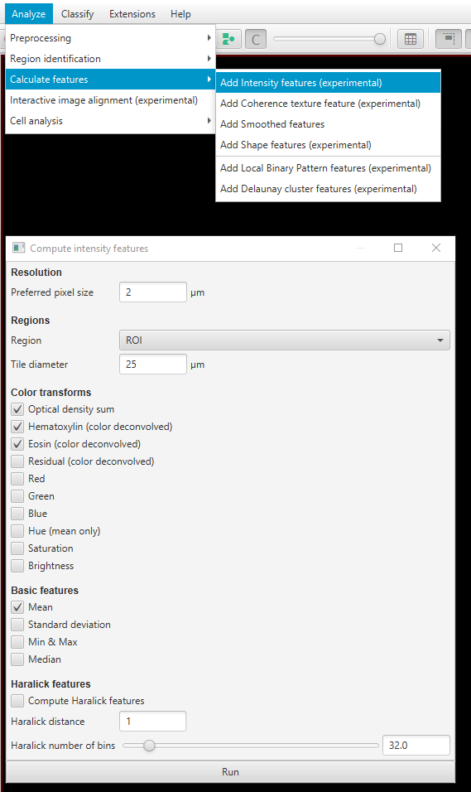
Measure the intensity
Let’s measure the Optical density (how opaque is the tissue) and the mean intensity of Hematoxylin and Eosin.
Tip: ctrl+L is a shortcut for Command List - search for intensity to quickly find needed command

Slide 9

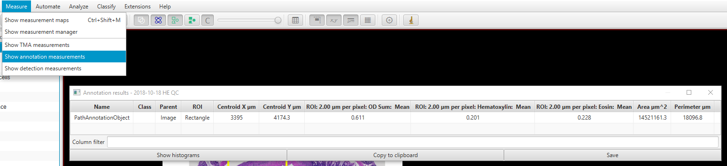
Export the data
Show annotation measurements and copy them to clipboard. You can also use
Tip: you can automate data export with a simple script

Slide 10
Evaluate the data
Click the link below to open Sheets. Plese type the values we need (OD, hematoxylin, and eosin mean values) in the results sheet. Keep adding to the list to help us build better statistics! Thanks!
https://docs.google.com/spreadsheets/d/1rSoNvVjoyXVB1UG82mFkEVlhheLUwBJVnt6Qhk1X22U/edit?usp=sharing

